Slide 1
Solving Equations
Unit 1 Algebra 1

Slide 2
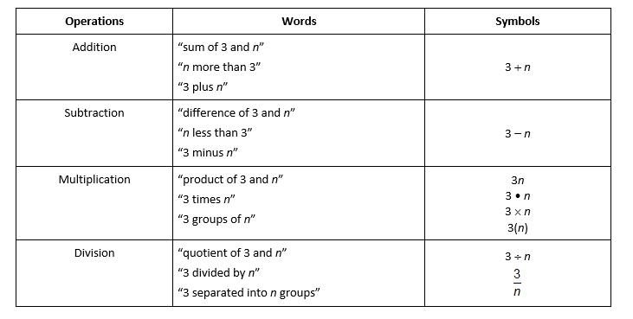
Words Into Symbols

Slide 3
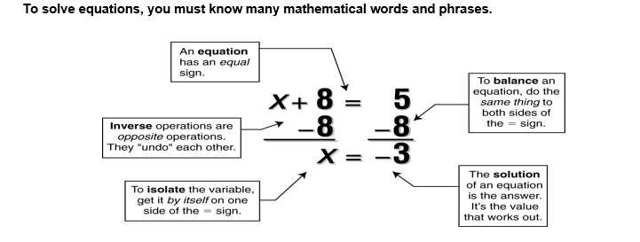

Slide 4
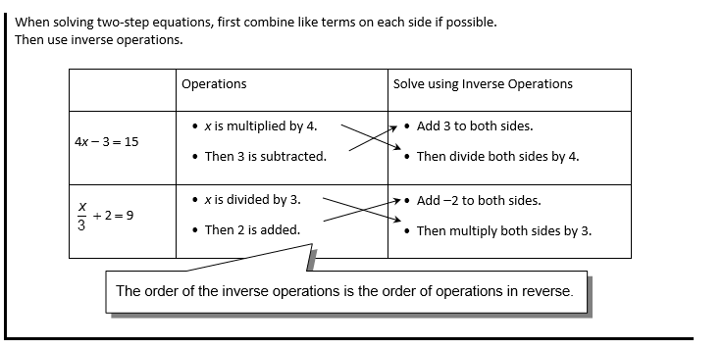

Slide 5

Examples:

Slide 6

Examples:

Slide 7
Examples:

Slide 8
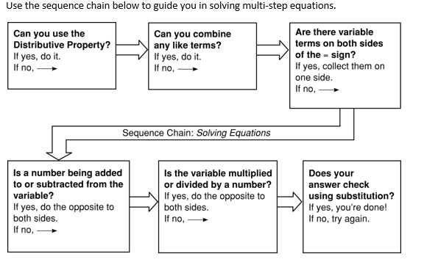

Slide 9

Example:

